Slide 1






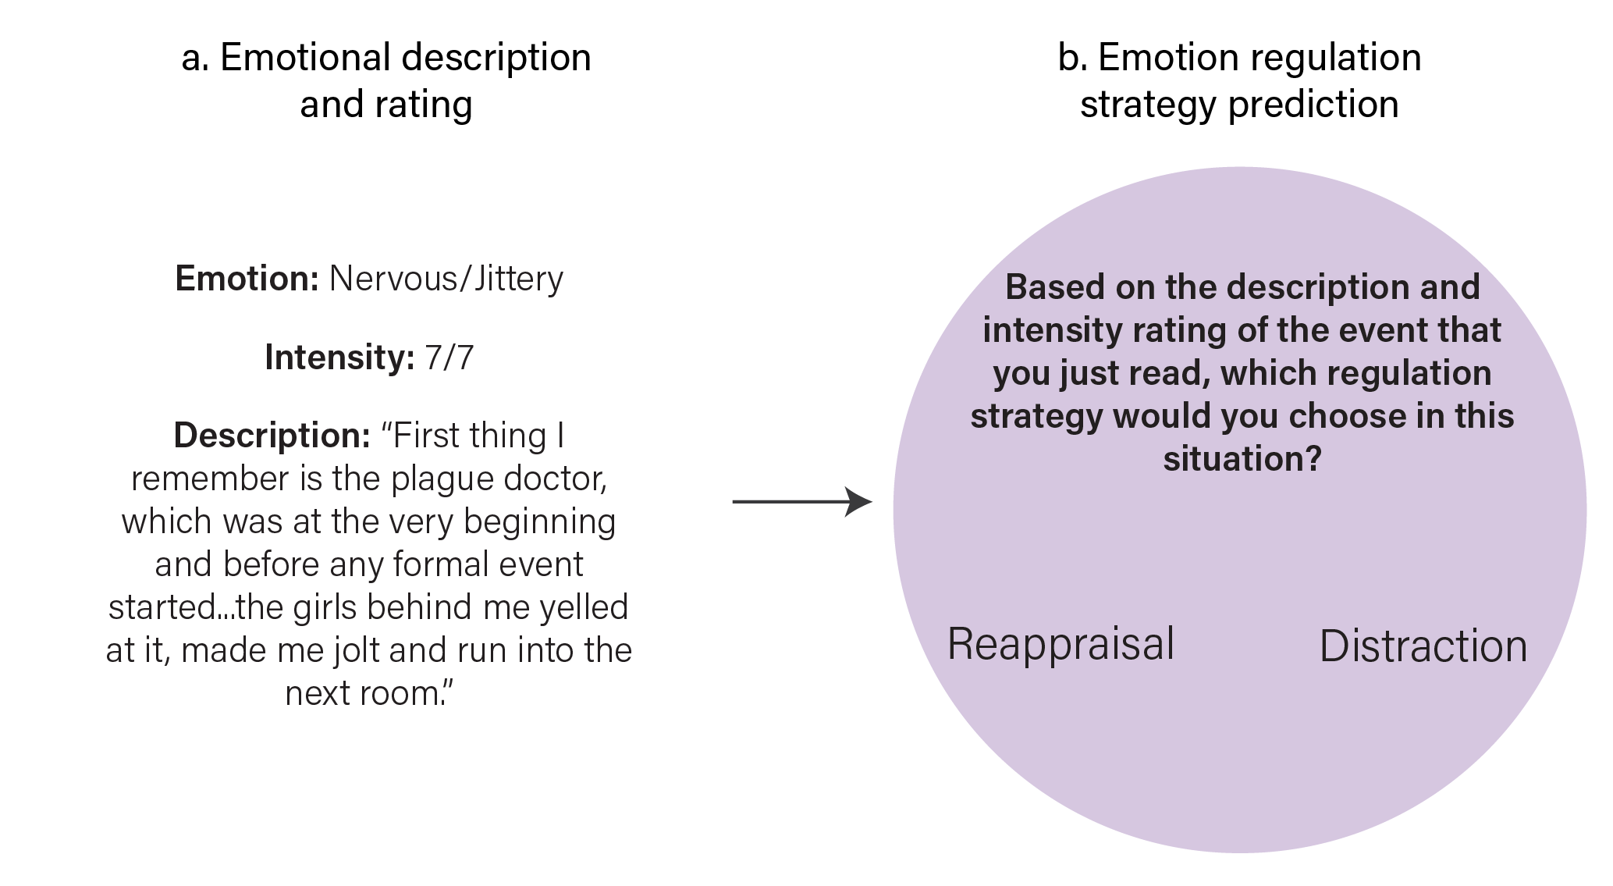




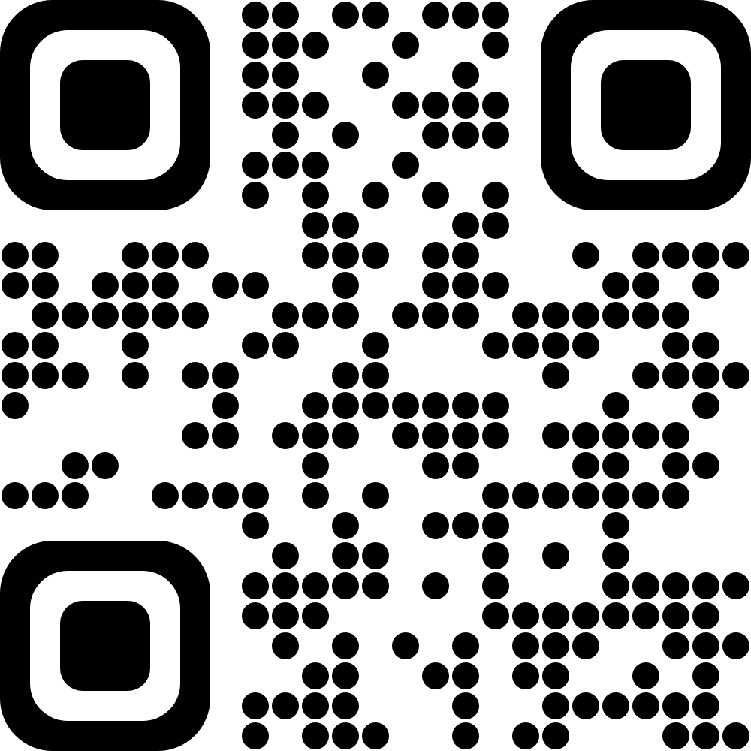


High-Intensity, Dynamic Stimuli Complicate
Emotion Regulation Strategy Usage
William Mitchell, Steven Martinez, Katelyn Cliver, Joanne Stasiak, David Gregory, Helen Schmidt, Vishnu Murty, & Chelsea Helion
Billy.Mitchell@temple.edu
@wjmitchell_
PROJECT MOTIVATION
RESULTS SUMMARY
Situations eliciting emotion regulation in our daily lives are often dynamic, multimodal, and sometimes intense. Our responses are often unprompted and unprepared. ¹
For these reasons, the strategies someone may choose to regulate their emotions in many studies may not reflect the strategies they use in daily life. ²
This series of studies used a variety of settings to study the effect emotional intensity has upon regulation strategy usage in high-intensity, dynamic situations using untrained participants. ³
STUDY 1: Participants who experienced a haunted house demonstrated no association between emotional intensity and strategy usage, even after applying a multiverse analysis approach (Fig A). Distraction was self-reported to be less effective as intensity increased, contrary to previous work (Fig B).
STUDY 2: Participants tasked with forecasting how they would regulate in haunted house situations demonstrated the hypothesized association between intensity and regulation strategy (Fig C). Forecasters matched experiencers in strategy selection less than chance for Distraction, but not Reappraisal (Fig D).
STUDY 3: While watching horror movie clips, emotional intensity demonstrated the hypothesized association with both strategy use and forecasting (Fig E). However, Distraction was used less often than Reappraisal by experiencers (Fig F), who reported it to be less effective than forecasters thought it would be (Fig G).
p > 0.05 N.S.
p ≤ 0.05 *
p ≤ 0.01 **
p ≤ 0.001 ***
N.S.
N.S.
***
OR = 1.36, 95% CI = [0.95, 1.95]
β = -0.28, 95% CI = [-0.40, -0.16]
Fig A
Fig B
HYPOTHESES
Fig D
x_{diff} = 0.328, 95% CI = [0.313, 0.342]
As emotion intensity increases, the probability of regulating via distraction increases, while reappraisal decreases. ⁴
Meta-analysis suggests this effect size is “very large” (r+ = 0.46 – 0.61) and consistent. ⁵
**
OR = 1.06, 95% CI = [1.02, 1.10]
***
Fig C
ANALYTIC APPROACH
Fig E
Fig F
Across all studies, Hierarchical Binary Logistic Regression was used to assess the hypothesized association between the intensity of negative emotion and which strategy was reportedly used or forecasted for each event.
Employed model testing using the information criterion method (i.e., BIC comparison), though model covariates differed across studies.
OR = 0.56, 95% CI = [0.36, 0.87]
χ2(1, N = 613) = 6.14
***
N.S.
Fig F
**
Frequency of Reported Strategies
**
x_{diff} = 10.3, 95% CI = [4.13, 16.62]
CONCLUSIONS
Fig G
Within high-intensity dynamic situations, Distraction, but not Reappraisal, was used less often and effectively than people thought it would be.
This contradicts conventional notions as to the strengths and weaknesses of some Process Model strategies.
This is likely a reflection of environmental ⁶ and action affordances ⁷, which demand greater attention within future research.
This project contributes to a pre-existing chorus emphasizing the need for greater ecological validity in the emotion regulation literature. ⁸
Affective Intensity
METHODS SUMMARY
STUDY 1: HAUNTED HOUSE EXPERIENCE
STUDY 2: REGULATION FORECASTING
STUDY 3: HORROR MOVIE CLIPS
118 Participants traversed Eastern State Penitentiary in October 2021
170 Participants read haunted house descriptions in July 2021
253 Participants completed a video regulation task in October 2023
REFERENCES
Participants were placed in groups (n = 31) of two to five people and led by researcher.
Groups progressed single file, instructed to experience the event as naturally as possible.
Participants were untrained and emotion regulation was not prompted.
Exposure lasted approximately 37 minutes on average.
After exposure, participants identified 3 emotionally salient events:
Descriptions of the events (Free response)
Emotions felt (Free response)
Emotion intensity (Likert Scale, 0-4)
Regulation strategy, if any (Free Response)
Regulation success (Likert Scale, 0-4)
Hypotheses-blind raters classified regulation according to Process Model (IRR = 0.877).
Participants were recruited via Prolific
They watched four randomly sorted video clips (120s each) sourced from lesser known horror films.
Participants watched the videos alone and reacted as they naturally would.
After each video, negative affective intensity was captured on a sliding 100 point scale.
After all videos were viewed, participants either reported the strategies they used or forecasted how they should regulate for each video. Options included Reappraisal, Distraction, or Neither.
Participants also recorded how effective the strategy they chose was or would be at reducing their affective intensity on a sliding 100 point scale.
Opitz, P. C., Cavanagh, S. R., & Urry, H. L. (2015). Uninstructed emotion regulation choice in four studies of cognitive reappraisal. Pers Ind Diff, 86, 455–464.
Sheppes, G. (2020). Transcending the “good & bad” and “here & now” in emotion regulation: Costs and benefits of strategies across regulatory stages. Adv in Exp Soc Psych, 61, 185-236.
Mitchell, W. J., Stasiak, J., … & Helion, C. (In Print). Emotion regulation strategy use and forecasting in response to dynamic, multimodal stimuli. J of Exp Psych: Gen.
Sheppes, G., Scheibe, S., Suri, G., & Gross, J. J. (2011). Emotion-Regulation Choice. Psych Sci, 22(11), 1391–1396.
Matthews, M., Webb, T. L., … & Sheppes, G. (2021). Identifying the determinants of emotion regulation choice: A systematic review with meta-analysis. Cog and Emo, 35(6), 1056–1084.
Uusberg, A., Taxer, J. L., … & Gross, J. J. (2019). Reappraising Reappraisal. Emotion Review, 11(4), 267–282.
Bramson, B., Toni, I., & Roelofs, K. (2023). Emotion regulation from an action-control perspective. Neurosci & Biobehav Rev, 153, 105397.
Aldao, A. (2013). The Future of Emotion Regulation Research: Capturing Context. Perspect on Psychol Sci, 8(2), 155–172.
Participants were recruited via Prolific
They reviewed 78 events described by people who experienced our pilot haunted house study in 2019, which included:
A description of each event
the emotions experienced in that event
the intensity of those emotions
Participants were then asked to forecast what strategy they would have used if they experienced the event.
SCAN TO VIEW THIS MANUSCRIPT
Made Possible By
UNION WAGES

